Slide 1
#4 Mission Prescription Decision Support for Clinicians
Sweden AMR Hacks
Dec 2019

Slide 2
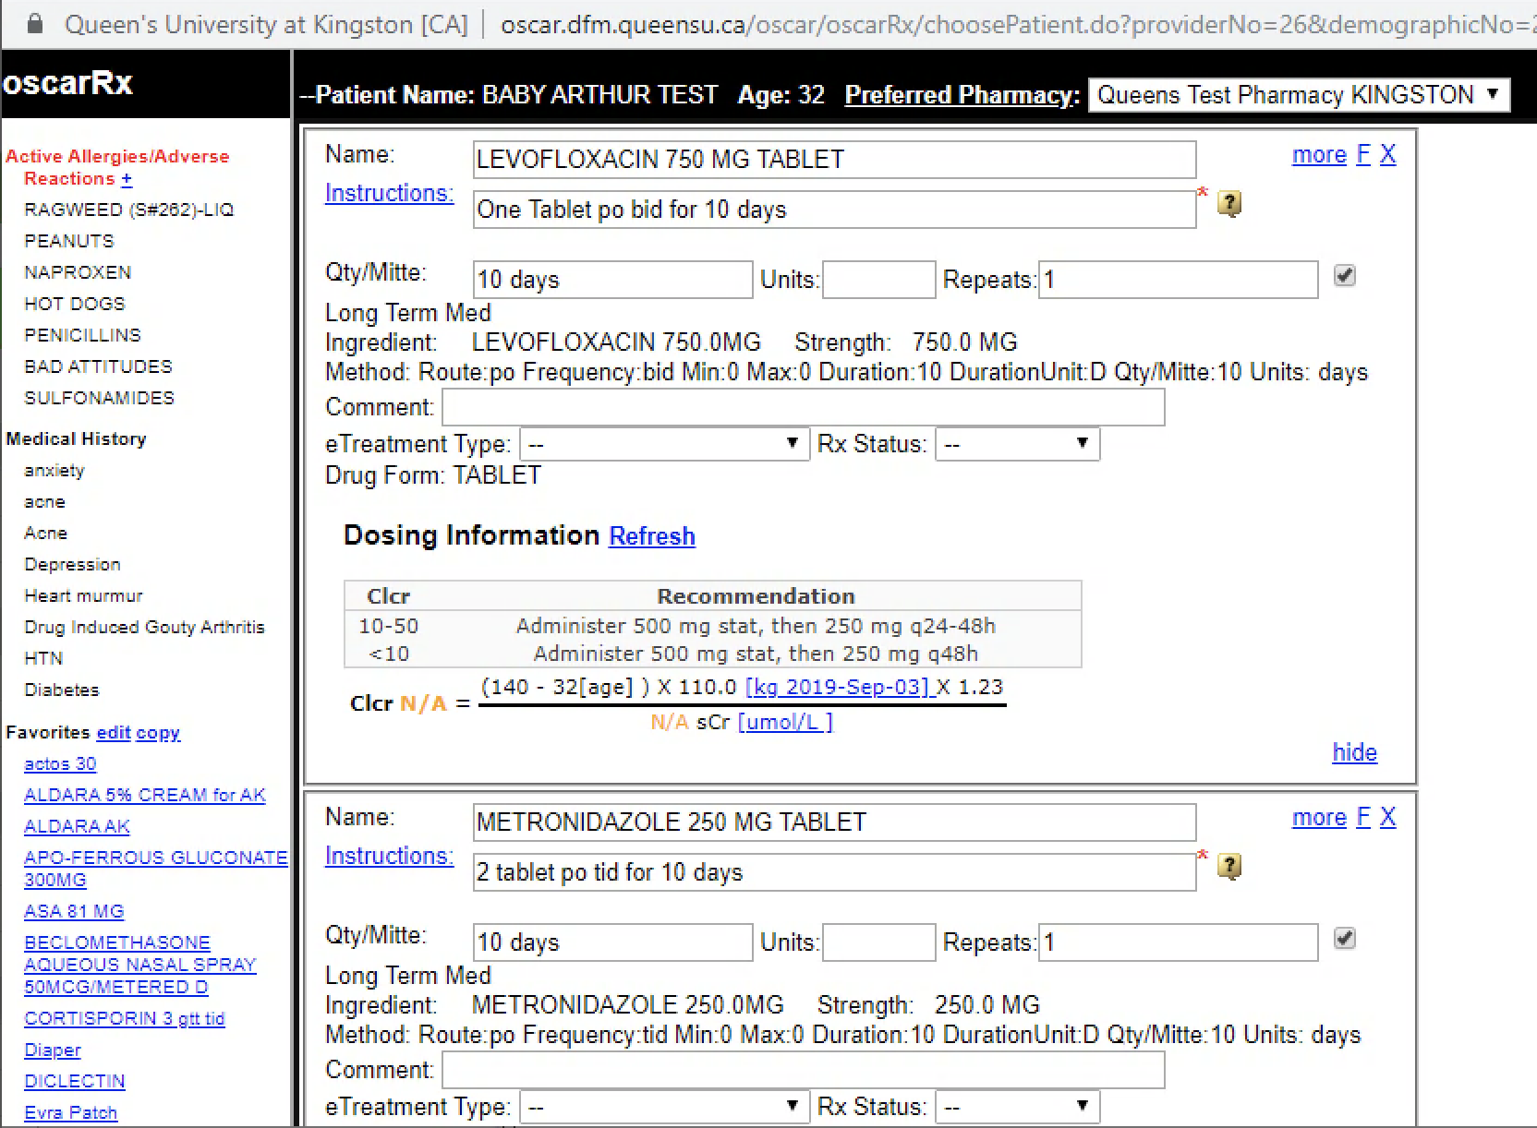
Jo needs to write an antibiotic prescription for a patient with a UTI
Prescriptions are written as free text, requiring active selection of the antibiotic every time
Clinicians show decision fatigue over their working day

Slide 3
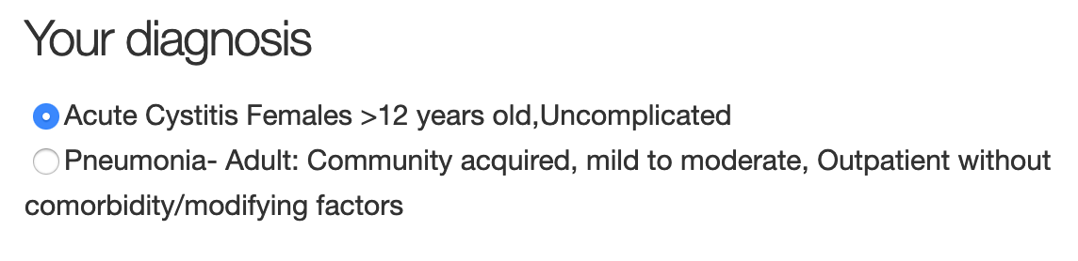
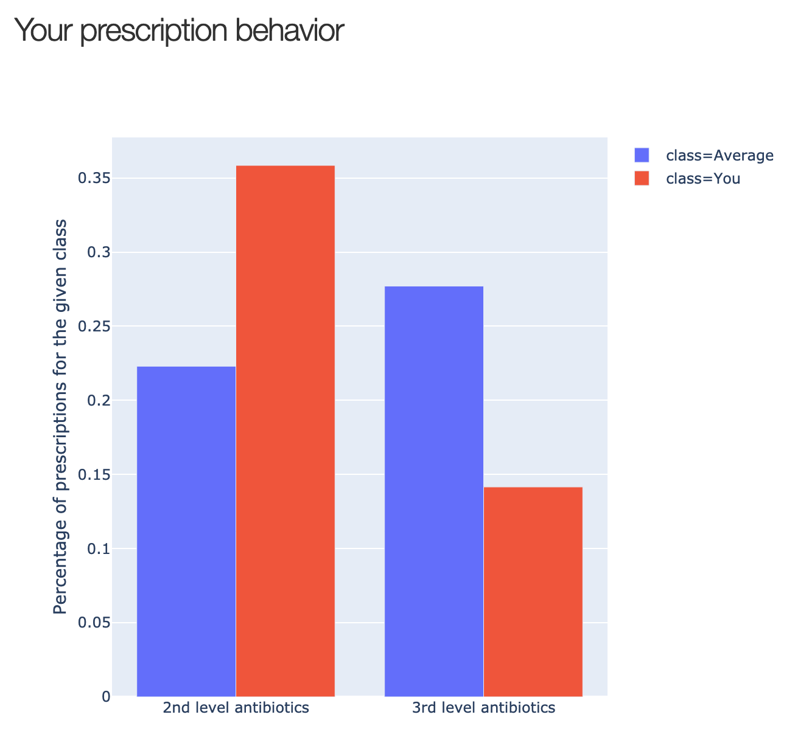
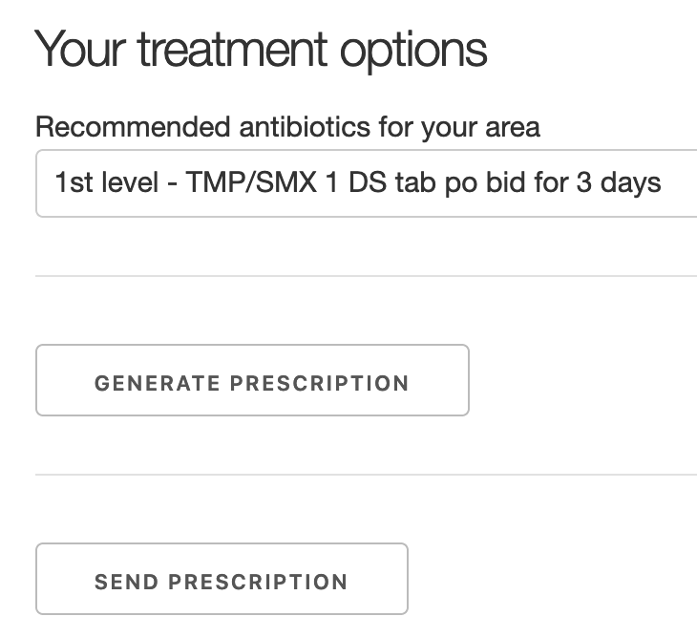
The module pre-selects the locally optimal prescription choice for Jo
1
3
2
“I think it’s great, I
would definitely use this module with my residents!”
- Family physician
Notes:
This is what Jo will see in the future when she needs to write a prescription, instead of the old free-text form. This is a module we built (app) that uses real data we have.
Start with a diagnosis
Rubber stamp or change manually
Be confronted with your prescription behavior
More prescription of effective 1st line antibiotics
Fewer prescriptions of 2nd and 3rd line antibiotics overall

Slide 4
Rolling out the module will save money through more efficient antibiotic prescriptions by Jo and her peers
Healthcare saving:
$1.94 per case
$3.5 million per year, Canada
Cost:
$200K-1 million
$100-200K, per year
Sensible - Sustainable - Scalable

Slide 5
Backup Slides

Slide 6

Economic case: Healthcare costs
UTI
Reducing AMR:
High estimate: 10% reduction, $140 million per year
Low estimate: 10% reduction, $2.2 million per year
Reducing ineffective antibiotic prescriptions:
Current: 12.7% vs. Guided 5.5%
Cost of this intervention:
$200K - $1 million + $100K-200K per year
Development then updating when guidelines update.
Empirical therapy, current
Local epidemiologically-guided empirical therapy
 | Use | Sens.
1.Nitro | 53% | 85.7%
2.Met. | 23% | 82.6%
3.Cipro | 24% | 96.9%
Area 1 Use
1.Nitro | 90%
2.Met. | 0%
3.Cipro | 10%
Area 2 Use
1.Nitro | 0%
2.Met. | 90%
3.Cipro | 10%
Costs: Antibiotics (1st and 2nd), repeat appointment (if 1st fails), hospitalisation (1% of those with AB failure)
Mean cost: $34.40
Mean cost: $32.46
= $1.94 per case saving, $3.5 million per year in Canada
Notes:
Impact
• Who will the solution impact: patient, prescriber, health system
• What is the degree of this impact: 1% to 10% improvement AMR reduction
• Extent of the impact the solution can have on AMR

Slide 7


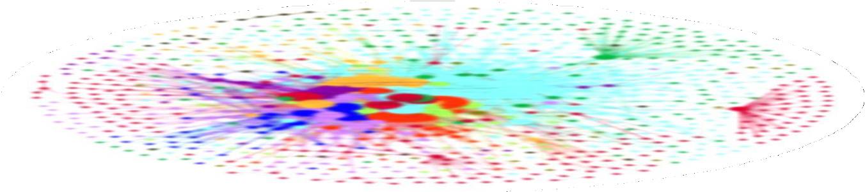







Opportunity to use data for surveillance and decision support
Federated EMRs: CPCSSN-hosted at university
ARx module
Data
Data
Data
Health Data Platform Initiative
EMRs
Rural/urban
Previous C&S
Age, Sex
Renal fxn
Trusted third party
PopDataBC
ARx module
Notes:
-this solution takes advantage of health data platforms that are being created in Canada and elsewhere
-creation of a antibiotic treatment module that uses data from electronic medical record (personal information and also information on prescribing patterns compared to other prescribers) and from the health data platform which would contain community antibiogram

Slide 8
Information Exchange
Notes:
Feasibility
• Implementation is possible from both a technical, process and change management perspective—this is actually happening in BC today—with other provinces interested
• Has real potential with likelihood for adoption and scale.
• Level of insight the team has into how this solution can be deployed.

Slide 9












Local Example: Linked community + hospital data + administrative data
Patients, Families
Admin data – MSP, pharma etc
FP/NP EMR
Specialist EMR
HA EMR / CIS
All members as data stewards
Trusted 3rd party for linking, de-identification
Data set covering entire patient journey
Only source practice can re-identify patient
Health
Authority
Notes:
Feasibility
• Implementation is possible from both a technical, process and change management perspective—this is actually happening in BC today—with other provinces interested
• Has real potential with likelihood for adoption and scale.
• Level of insight the team has into how this solution can be deployed.

Slide 10
Impact: evidence based decision-making = better quality of care = decreased costs
Primary Care:
Individual and group prescribing behaviours
Optimizing antibiotic use based on resistance data
Patterns of AMR and resulting outcomes
Public Health:
To what extent are the antibiotic prescribing guidelines followed?
What is the relationship between AMR and usage at the community level?

Slide 11



Opportunity to use data for surveillance and decision support
Health Authority
VCH
PHSA
PHC
Ministry of Health
Data
Data
Data
Federated EMRs: CPCSSN-hosted at university
Data
CST
PCM
Healthideas
Health Data Platform Initiative
EMRs
Trusted third party
PopDataBC
Consumer
Provincial analytics platform, public asset
Federated system, on-demand discovery & aggregation
Trusted external third party doing linking, de-identification
Streamlined data access processes

Slide 12


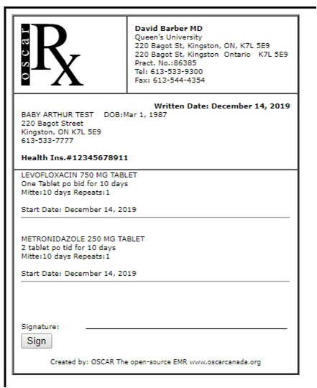
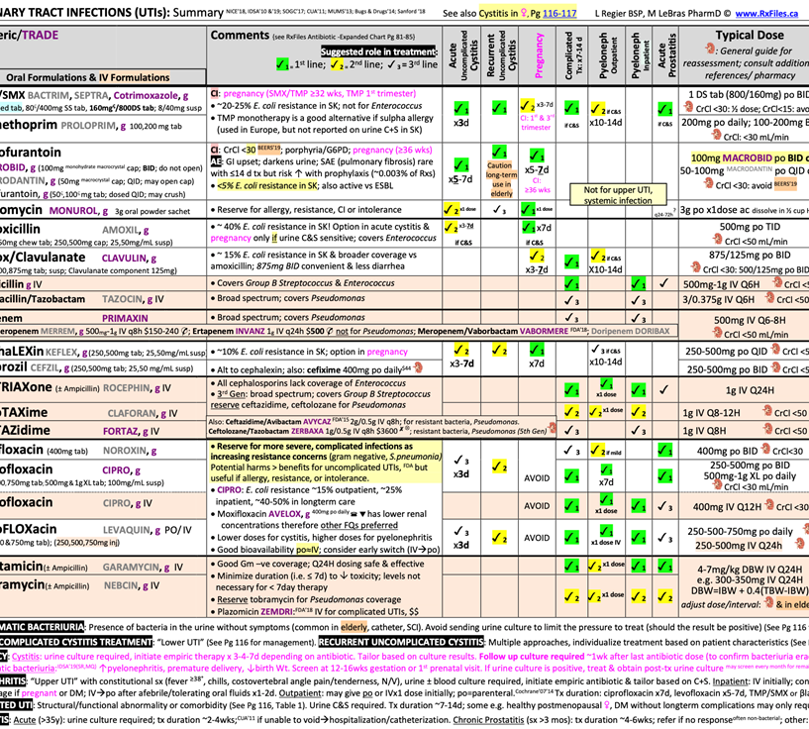





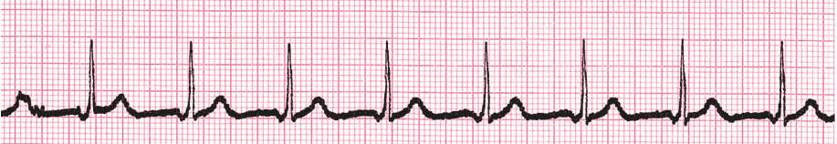

Kristina visits primary care
Female, 39 years of age
-pain on peeing, dysuria, feeling unwell, urinary frequency
Notes:
-this process is basically taking the old ways of prescribing and doing it electronically
-Health System remains largely acute care focused, not on community based practices.
-Critical health information locked in systems or on paper; difficult for care givers to provide coordinated end to end patient care across care continuum

